Slide 1
ALL FONT - MONTSERRAT
WHERE VISION TAKES FORM
WEBSITE TAKING FORM. LAUNCHING SOON.

Slide 2

SHAPING FORM DEFINING FUTURE
A dynamic team of enthusiastic structural engineers and designers, dedicated to crafting spaces that are not only robust and functional but also inspire creativity and innovation. We seamlessly merge technical proficiency with practical wisdom to create structures that prioritize safety, efficiency, and alignment with architectural vision and user requirements.
Structural Integrity
Functional Design
Design safe, reliable Structural systems
Create spaces that meet user needs
Technical Expertise
Collaborative Insight
Apply engineering principles and best practices
Integrate architecture and practical feedback

Slide 3
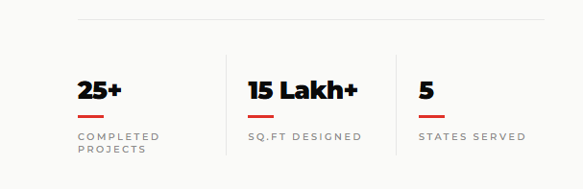

Slide 4
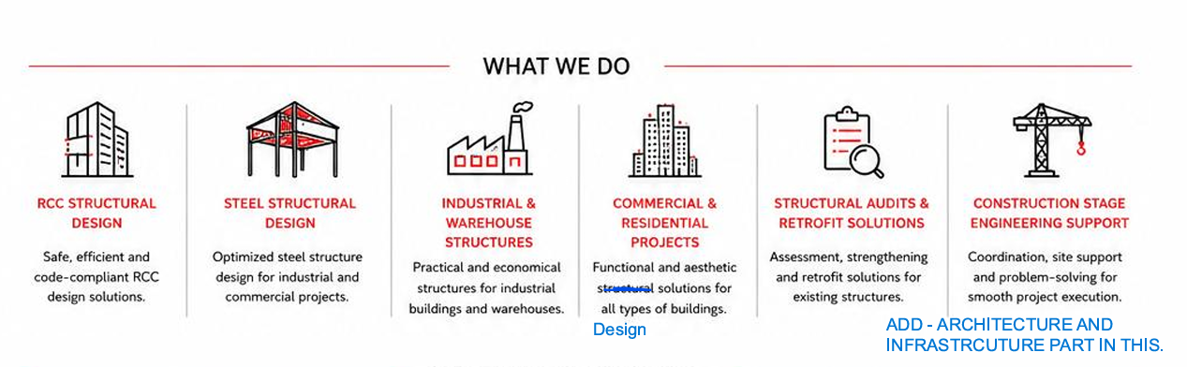
Architecture
Infrastructure

Slide 5
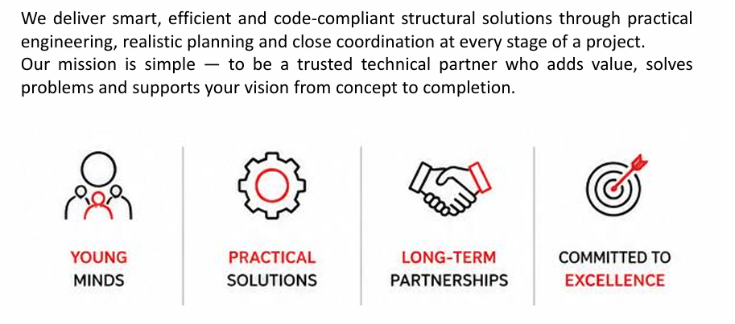

Slide 6
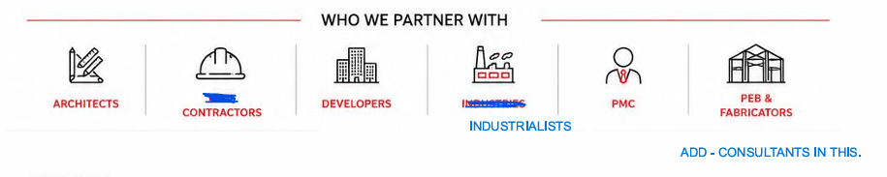
Consultant

Slide 7
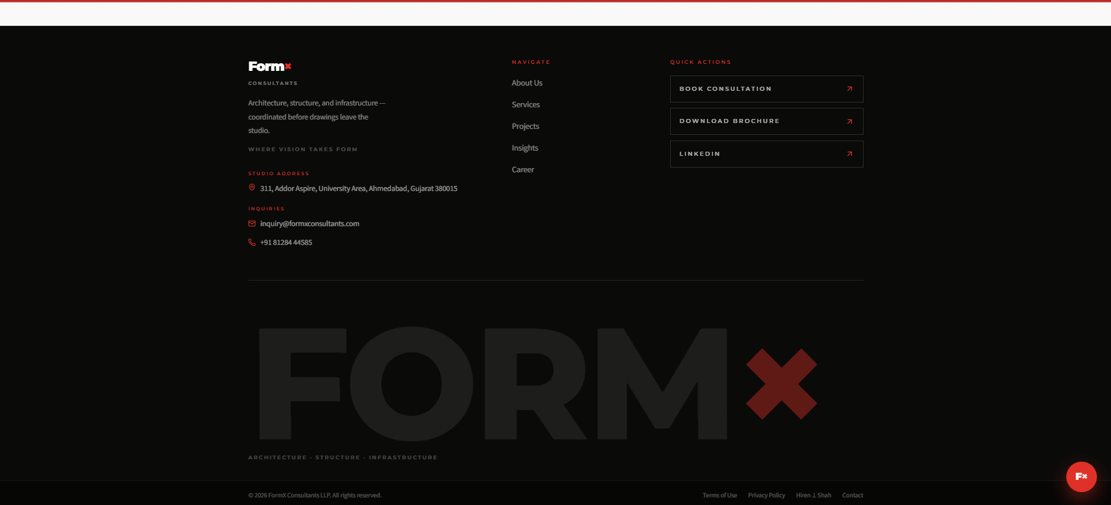
FOR MORE INFORMATION ABOUT OUR PROJECTS PLEASE DOWNLOAD OUR BROCHURE FROM LINK BELOW
WHATSAPP LOGO

